Slide 1
Vector and pipelined processors
Chapter 3

Slide 2
Classification of Pipeline Processors
Various types of pipelining can be applied in computer operations.
These types depend on the following factors:
Levels of processing
Pipeline configuration
Types of instruction and data

Slide 3
Based on the levels of processing (Handler’s Classification)
According to the levels of processing, Handler proposed three classification schemes.
Arithmetic pipeline
Processor pipeline
Instruction pipeline

Slide 4

1. Arithmetic Pipeline
An arithmetic pipeline generally breaks an arithmetic operation into multiple arithmetic steps that can be executed one by one in segments in Arithmetic Logic Unit.
In arithmetic pipeline, the ALU of a computer is segmented for pipeline operations in various data formats.
For example:
4-stage pipeline in Star-100
8-stage pipeline in TI-ASC
14-stage pipeline in Cray-1
26-stage pipeline in Cyber-305

Slide 5
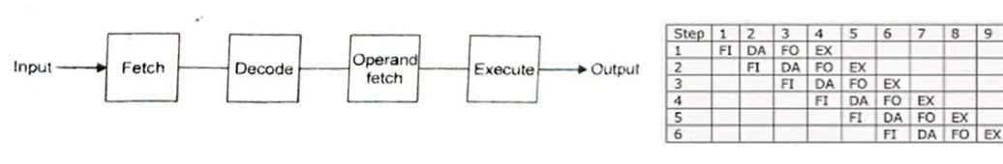
2. Instruction Pipeline
In instruction pipeline, the execution of a stream of instructions can be pipelined by overlapping the execution of the current instruction with the fetch, decode and operand fetch of subsequent instructions.
This technique is also known as look ahead.
Example: Almost all high-performance computers nowadays are equipped with instruction pipeline processor.

Slide 6
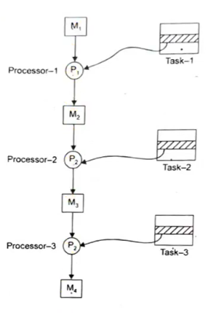
3. Processor Pipeline
In processor pipeline processing, the same data stream is processed by a cascade of processors. Each processor performs a specific task.
The data stream passes the first processor with results stored in a memory block which is also accessible by second processor.
The second processor processes this result and passes it to third and so on.
This pipeline processor is not much popular. There is no practical example found for processor pipeline.

Slide 7
Based on Pipeline Configuration (-Ramamoorthy and Li’s Classification (1977))
According to pipeline configuration and control strategies, Li and Ramamoorthy have proposed the following pipeline classification:
Unifunction vs. Multifunction Pipelines
Static vs Dynamic Pipelines

Slide 8

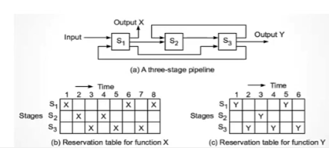
1. Unifunction vs. Multifunction Pipelines
Unifunction Pipeline: A pipeline with fixed and dedicated function is called a Unifunction pipeline.
Eg. Floating point adder
The Cray-1 has 12 unifunctional pipeline units for various scalar, vector, fixed point and floating point operations.
Multifunction Pipeline: A pipeline that performs different functions either at different times or at the same time, by interconnecting different subsets of stages in the pipeline is called a Multifunction pipeline.
Eg.. TI-ASC has multifunction pipeline processors.

Slide 9


2. Static vs. Dynamic Pipelines
Static Pipeline:
Static pipeline assumes only one functional configuration at a time.
It can either be unifunctional or multifunctional.
Static pipelines are preferred when instructions of same type are to be executed continuously.
A unifunction pipeline must be static.
Dynamic Pipeline:
Dynamic pipeline permits several functional configurations to exist simultaneously.
A dynamic pipeline must be multi-functional.
The dynamic configuration requires more elaborate control and sequencing mechanisms than static pipelining.

Slide 10
Based on types of instructions and data: Scalar vs. Vector Pipelines
According to the types of instruction and data, following pipeline types are identified under this classification:
Scalar Pipelines: This type of pipeline processes scalar operands of repeated scalar instructions (i.e processes scalar operands under the control DO LOOP). Instructions in a small DO loop are often prefetched into the instruction buffer. The required scalar operands for repeated scalar instructions are moved into a data cache in order to continuously supply the pipeline with operands.
Eg. IBM-360
Vector Pipelines: This type of pipeline processes vector instruction over vector operands. Computers having vector instructions are often called vector processors. The design of a vector pipeline is expanded from that of a scalar pipeline.
Eg. STAR-100, Cray-1

Slide 11
System Performance Attributes
Clock Rate and CPI: The CPU of digital computer is driven by a clock with a constant cycle time (Ʈ in nano seconds).
Clock Rate: The inverse of the cycle time is the clock rate.
f = 1/Ʈ in megahertz.
Instruction Count: The size of a program is determined by its instruction count in terms of the number of machine instructions to be executed in the program.
Cycles Per Instruction (CPI): CPI is the parameter for measuring the time needed to execute each instruction. Different machine instructions may require different clock cycles to execute.

Slide 12
Performance Factor: The CPU time or execution time (T in seconds/program) needed to execute the program. It is estimated by:
T= I_{c} x CPI x Ʈ = I_{c} x CPI x 1/f

